Slide 1
Genetically Modified Crops
Justin, Michael, Jessenia, Hina

Slide 2
Background
1977: Frederick Sanger developed a way to allow scientist to read the nucleotide sequence of a DNA molecule
1980: The first genetically modified mouse
1983: Kary Mullis developed a way to reproduce bits of DNA faster than ever; she won a Nobel Prize for this in 1993
1980’s-1990’s: China sells the first genetically modified crops
1990: Chymosin from a genetically modified source was used to make hard cheese

Slide 3
Background
1993: FDA approves the use of Bovine somatotropin, a hormone used to increase milk production in cows, for commercial use
1994: Genetically modified crops, Flavr Savr tomato, begin to sell throughout the United States

Slide 4
What Exactly IS A Genetically Modified Crop?
A plant may have undesirable weakness to temperature or disease.
Editing a plant by adding DNA of another plant, bacteria or virus.
The changed plant obtains the benefit of new characteristics.
New plant can resist disease or produce increased yields.

Slide 5
Pros
Plants produce their own pesticides increasing resistance to pests.
GMC’s can be modified to increase resistance to disease/fungus.
Better environmental adaptation to less-than-optimal climates
Stronger resistance to herbicides, allowing easier killing of weeds in crops.
Can be modified to have increased nutritional value.
Plants can be modified to produce pharmaceutical medicines for easy distribution.
Can be modified to increase production of fruits and vegetables.
Drought tolerant plants reduce strain on water resources.

Slide 6
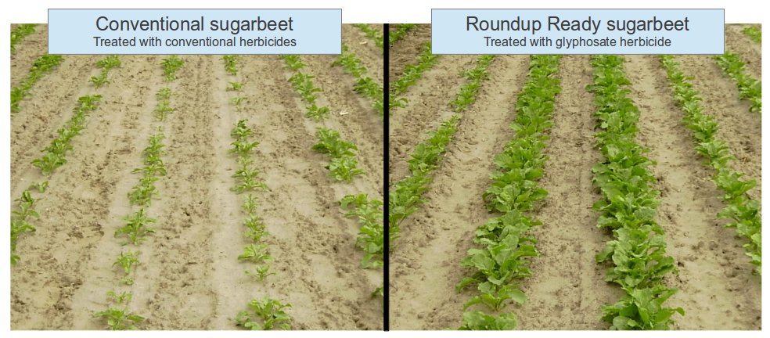
Pros
Allow farmers to gain more yield from the same area.
Modifications can be made as new needs arise, which is not possible with traditional breeding methods.

Slide 7
Cons
Harm to kidneys, liver, heart, and other organs
US does not require GMO foods to be labeled as such
Could cause new allergies and hurt effects of antibiotics (no studies confirm this)
Rise of “superweeds’: crops built to survive weed killers could breed with weeds, would have to use more + stronger pesticides to keep it under control

Slide 8
Cons (cont.)
GM Pesticide-Producing Crops:
toxic to harless non-target species
toxic to beneficial insects
threat to soil ecosystems
risk for aquatic life
new pests fill in where old ones die
GM Herbicide Tolerant (HT) Crops
toxic effects of herbicides on ecosystems
increased weed tolerance to herbicide

Slide 9
Cons (cont.)
Effect on Health
unknown if GM crops safe for human or animal consumption
independent scientific studies on safety of GM crops are severely lacking; tendency fot studies conducted by researchers w/ affliations to GM industry to give favorable results
do have more potential to cause allergenic reactions than conventional crops
use of Cry1Ab toxin may be dangerous for pregnant woman
Roundup may be toxic to mammals; could interfere with hormones

